Slide 1
NeST REST Integration Report
Submitted by TEAM BUG_INSPECTORS

Slide 2
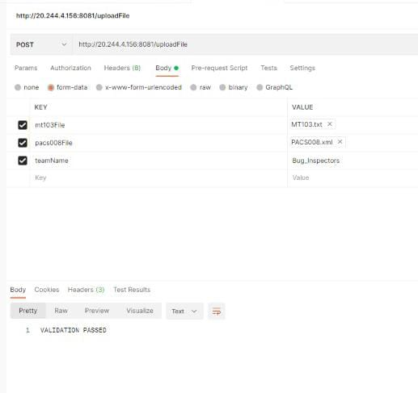
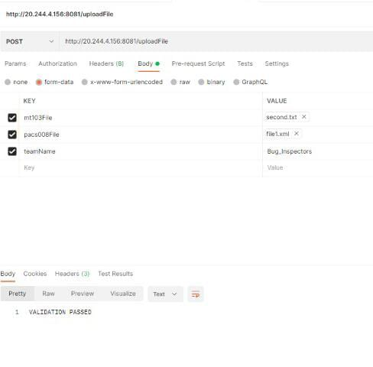
NeST REST Integration Report
Our program got 100 percent success rate with all test cases being passed. Including the validation of input and output files.
The MT file was firstly passed in our program for conversion . After conversion both input and output files were uploaded on Postman app along with team name to get results.
The final result “VALIDATION PASSED” was received in the end.

